Slide 1
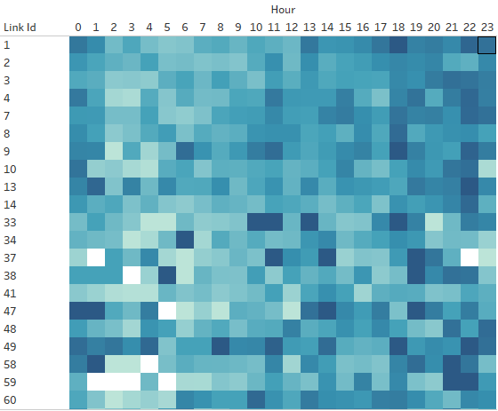
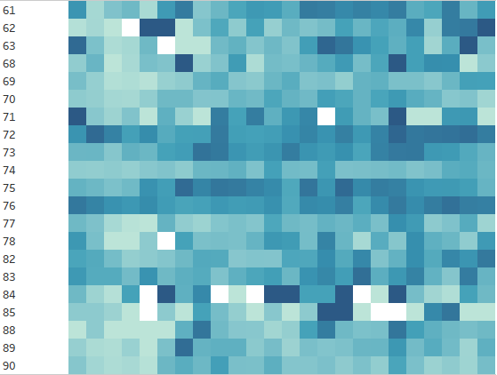



1/27/2016

Slide 2
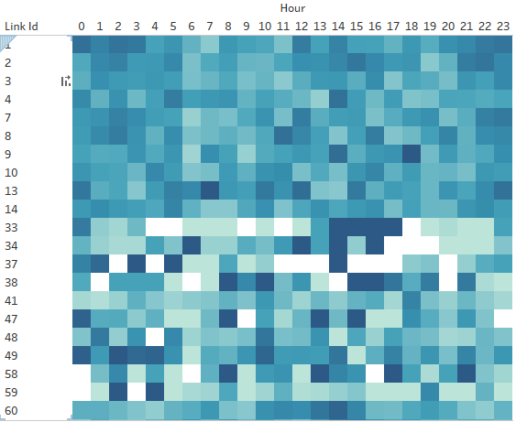
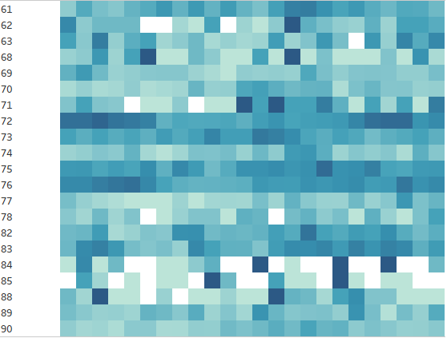
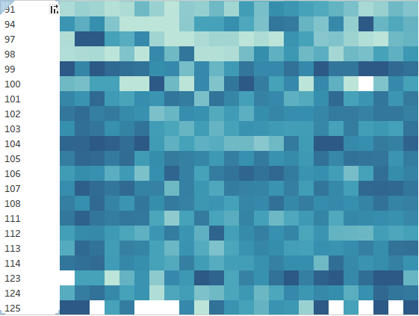


06/18/2016

Slide 3
11/16/2016

Slide 4
11/26/2016

Slide 5
12/02/2016

Slide 6
12/03/2016

